Slide 1
Chemical Equilibrium and Acid-Base
Chapter 15 and 16

Slide 2
Topics Covered Chapter 15
15.1 - 15.2: Concept of Equilibrium and the Constant
15.3 Working with Keq
15.5 - 15.6: Calculating Keq and Application
15.7: Le’Chatelier’s Principle
Group Project

Slide 3
Topics Covered Chapter 16
16.1, 16.2: Review and Bronsted Lowry
16.3: Autoionization of Water
16.4: pH Scale
16.5, 16.6, 16.7: Strong Acids/Bases, Weak Acid/Base
16.8: Ka and Kb
16.9: Acid Base Behavior and Lewis Acid/Base

Slide 4
Problem Set
1, 2, 4, 13, 15, 17, 19, 29, 37, 41, 43, 47, 51, 57, 69, 75, 101

Slide 5
15.1 Basis of Principle
Some reactions are non reversible
Others are in dynamic equilibrium (reversible)
Le’Chatelier’s principle investigates how equilibrium is effected by outsides stresses on the system
Systems at equilibrium are noted by a two way arrow
↔

Slide 6
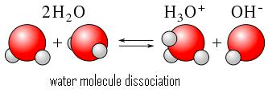
Self Ionization of Water
Water is in dynamic equilibrium
As a hydronium ion and an OH- ion are being formed…
Somewhere else in the system 2 water molecules are being formed
Otherwise the pH would constantly be fluctuating
This is self ionization of water, which we investigate further in chapter 16

Slide 7
What is equilibrium?
Equilibrium is accomplished when the forward and reverse reactions are happening at the same rate
Seemingly nothing is happening but..
At the molecular level products are being formed while reactants are simultaneously being created
at the same rate

Slide 8
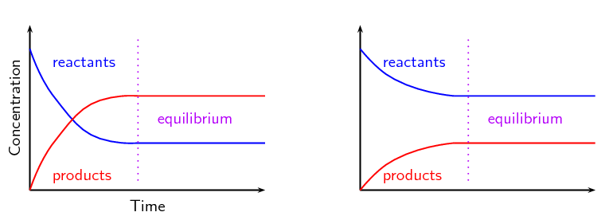
Graphical Representation

Slide 9
15.5 Calculating Keq or Kp
Write the equilibrium expression
Substitute known values for reactants and products
Interpret the meaning in the value of the equilibrium constant

Slide 10
Equilibrium Expression
aA + bB —> cC + dD
Keq = [C]^{c}[D]^{d}/[A]ª[B]^{b}
If a reaction is product favored, Keq will be large
Keq >> 1
If a reaction is reactant favored, Keq will be small
Keq << 1
No pure liquids or solids in equilibrium expression
Their concentrations are 1

Slide 11
Example
CaCO3 (s) ↔ CaO (s) + CO2 (g)
Write the expression
Can also be written as Kp

Slide 12
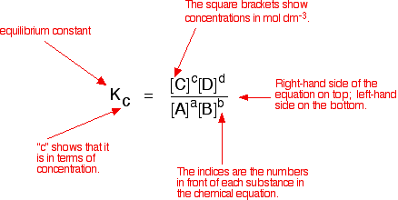
Keq Breakdown

Slide 13
Calculating Keq or Kp
But we often do not know the concentrations of all species in the system
If we know the concentration of one however, then we can use stoich to find the others

Slide 14
Calculating Keq or Kp
1. Tabulate all the known initial and equilibrium concentrations of the species appear in the Keq expression
2. For those species for which both initial and equilibrium concentrations are known, calculate the change in concentration that occurs as the system reaches equilibrium
3. Use stoich to calculate the changes in concentration for other species
4. From initial concentrations and changes in concentration, calculate the equilibrium concentrations

Slide 15
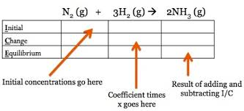
ICE Table

Slide 16
ICE Tables
Example:
H2 (g) + I2 (g) ↔ 2 HI (g)
Initial conc. of H2: 1.000 x 10 ^ -3 M
Initial conc. of I2: 2.000 x 10 ^ -3 M
Conc. of HI at Equilibrium: 1.87 x 10 ^ -3 M

Slide 17
15.6 Applications of Equilibrium Constants
Predicting the direction of reaction
Q = equilibrium quotient
K = Q, reaction is at equilibrium
Q > K, Conc. of reactants is too large, reaction is going to shift towards reactants (right to left)
Q < K, Conc. of products is too small, reaction will shift toward products (left to right)

Slide 18
Evaluating Q
System at the same temperature has the following concentrations:
[HI] - 1.0 x 10 ^ - 2 M
[H2] - 5.0 x 10 ^ -3 M
[I2] - 3.0 x 10 ^ -2 M
Calculate Q (reaction quotient) and predict the shift in equilibrium.

Slide 19
Calculating Keq from initial conc.
This technique will also come up in acid base
Useful in determining Keq from initial concentrations when the concentrations of products at equilibrium are not known

Slide 20
Calculating Keq from initial conc.
H2 (g) + I2 (g) ↔ 2 HI (g)
Initial conc of H2: 1.000 M
Initial conc. of I2: 2.000 M
What are the molar equilibrium concentrations if Keq at 448 degrees C is 50.5?
Use an ICE table and check at the end!

Slide 21
ICE table practice
15.49
For the reaction I2 (g) + Br2 (g) ←→ 2IBr
Kc = 280
Suppose 0.500 mol of IBr is allowed to reach equilibrium in a 1 L flask at 150 degrees Celsius. What are the eq. concentrations of I2, Br2, and IBr?
Hint Kc is for the forward reaction.

Slide 22
Le’Chateliers Principle
Predicts an equilibrium shifts due to stresses on the equilibrium
Think about your body…
If you are really hot you begin to sweat
If you are cold you begin to shiver
Your body is attempting to maintain thermal equilibrium

Slide 23
Le’Chateliers Principle
Types of stresses we will investigate
Adding/Removing a Reactant/Product
Changing the pressure by changing volume
Changing the Temperature

Slide 24
Adding/Removing (Conc.)
If a chemical system is at equilibrium and we add a substance (reactant or product) the reaction will shift so as to reestablish equilibrium by consuming part of the added substance
Conversely, removing a substance shifts equilibrium so that it is reformed

Slide 25
Le’Chateliers Principle
Adding/Removing a Reactant
Adding a reactant will cause the equilibrium to shift right so that the reactant is consumed and equilibrium is reestablished
Removing a reactant will cause the reaction to shift left to produce more reactant and reestablish equilibrium

Slide 26
Le’Chateliers Principle
Remember, all of these situations apply to a system that is already at equilibrium
Adding/Removing a Product
Adding a product will cause the equilibrium to shift left so that the product is consumed
Removing a product will…..

Slide 27
Changing in Volume
Reducing the volume of an equilibrium mixture of gas causes the system to shift in the direction of that reduces to the number of moles of gas
Converse is also true, increased volume —> more moles of gas
Why? This reduces the amount of pressure on the container…
Can I change the pressure through volume change on a liquid

Slide 28
Example
N2O4 (g) —> 2 NO2 (g)
How will this equilibrium shift due to change in pressure through volume change?

Slide 29
Change in Temperature
For Le’Chatliers princible we will treat heat as a product (for exothermic) and as a reactant (for endothermic)
Remember, if a system is at equilibrium and something is removed, the shift will be in the direction as to replace it.
Therefore, removing heat from an exothermic reaction will cause the reaction to shift to the right and vice versa

Slide 30
Addition of Catalyst
Because the forward and reaction occur at the same rate, there is no effect on equilibrium

Slide 31
Summary

Slide 32
Topics Covered Chapter 16
16.1, 16.2: Review and Bronsted Lowry
16.3: Autoionization of Water
16.4: pH Scale
16.5, 16.6, 16.7: Strong Acids/Bases, Weak Acid/Base
16.8: Ka and Kb
16.9: Acid Base Behavior and Lewis Acid/Base

Slide 33
16.1 Intro
Large portion of chemistry can be understood with acids and bases
Typically only takes place in liquids and aqueous solutions (but can occur in gases…rarely)
Really acids and bases are like a tug of water on electrons and protons between compounds and elements who are more capable to change their structure
Most acid-base systems are in dynamic equilibrium

Slide 34
16.1 Review
Historically chemists have sought to relate acidity and basicity to their molecular structure
Svante Arrenhius linked acid behavior with the presence of H+ ions and base behavior with presence OH-
i.e. HCl, H2SO4, HNO3 or KOH, NaOH, etc
An Arrhenius acid is a substance that dissociates in water to form hydrogen ions or protons
HCl (g) → H+ (aq) + Cl- (aq)

Slide 35
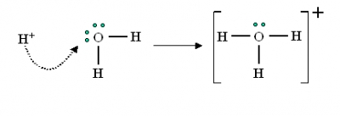
16.2 Bronsted Lowry
Classify Acids and Bases in regards to proton transfer (H+)
Protons interact very strongly with nonbonding electron pairs
In water H+ bonds to H20 to from a hydronium (H3O+)

Slide 36
16.2 Bronsted Lowry
We will use H+(aq) and H30+ (aq) interchangeably, which is very common in chem
H+(aq) is used shorthand notation, although the formation of a hydronium ion is a more accurate representation

Slide 37
16.2 Bronsted Lowry
Definition:
Bronsted - acid : an acid is a molecule or ion that can donate a proton to another substance
Bronsted - base: a base is substance that can accept a proton

Slide 38
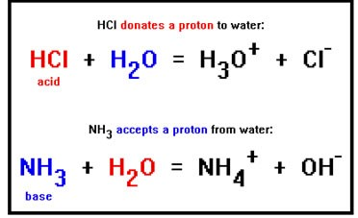
16.2 Bronsted Acid Examples

Slide 39
16.2 Another Example
Notice that the ammonia acts a Bronsted-Lowry base because it accepts a proton…
Also an Arrenhius base because it increases OH- concentration

Slide 40
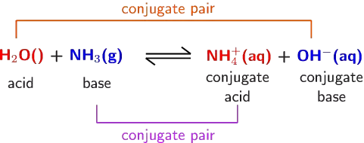
16.2 Conjugate Acid-Base Pairs
In any acid-base equilibrium, both the forward and reverse reaction in involves proton transfer
Every acid has a conjugate base (conjugate just means a pair)

Slide 41
Predicting Equilibrium (Kc)
Predict the direction of equilibrium comparing the strengths of the bases
Is the value of K greater than or equal to 1?

Slide 42
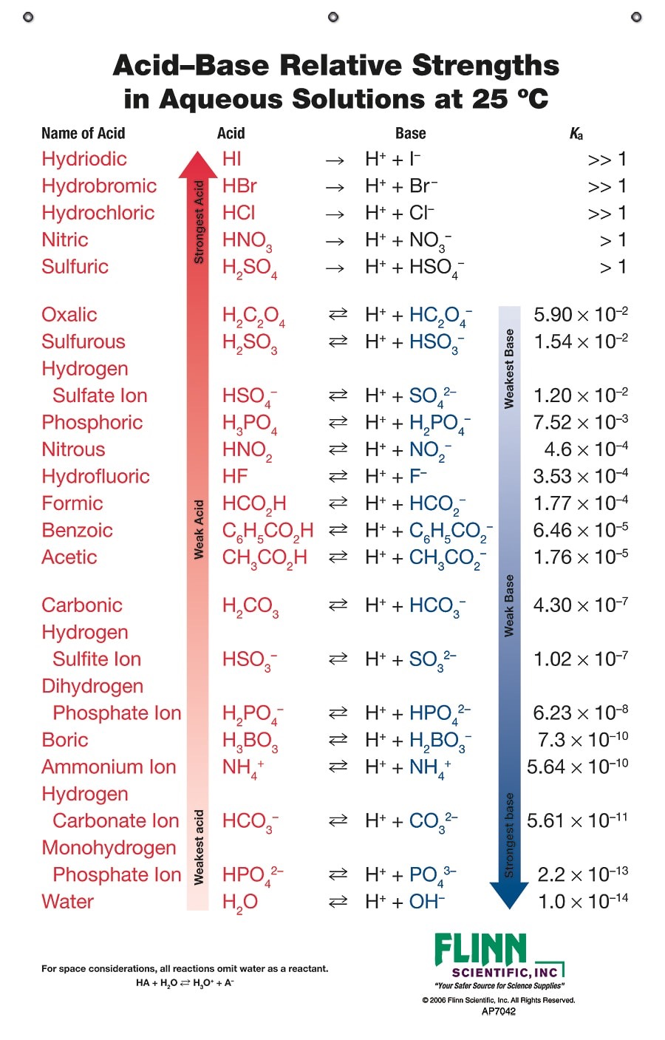

Slide 43
16.2 Relative Strengths
Strong Acids - completely give up their protons and their conjugate bases are weak proton acceptors (100% dissociation)
Weak acids - only partially dissociate in aqueous solutions (conjugate bases of conjugate acids are also weak)
Negligible activity - (CH4) molecules who contain hydrogen but show no acidic behavior (their conjugates are very strong bases, 100% protonated in water CH3-)

Slide 44
16.2 Identifying Conjugates
Identify the conjugate acids of the following
HSO3-
F-
PO43-
CO

Slide 45
16.2 Conjugate practice

Slide 46
16.3 Auto (self) ionization of water
A unique property of water is that it can act as either a Bronsted Acid or Base depending on the conditions (really important)
In the presence of acids, water is a proton acceptor
In the presence of bases, water is a proton donor

Slide 47
16.3 Ion Product of Water
Kw = [H30+][OH-] (notice water is excluded)
Kw = 1.0 x 10 ^ -14
This value is so low because in a system of water, only about 2 in 1 billion water molecules is ionized
The equilibrium is reactant favored

Slide 48
16.3 Ion Product of Water
1.0 x 10 ^ -14 = [H30+][OH-]
This relationship is important because not only does it apply to water but….
This relationship can be applied to any dilute aqueous solutions, other ionic effects can be ignored for approximations
In general, hydronium ions and hydroxide ions are in balance, which gives water a neutral pH of 7
Can be used to solve for H+ or OH- when one or the other is known.

Slide 49
16.4 pH scale
pH scale is a logarithmic function based upon the concentration of [H+] or [H30+]
The concentration of H+ in solution is usually very small, hence the use of the logarithmic function
Calculated ph = -log[H+]
If you have OH- concentration, then you can solve for H+ using ion product of water
-log [1.0 x 10 ^ -7] = 7.00 —> Neutral

Slide 50
16.4 Why is that useful
If we know OH- concentration, then we can solve for H+, and then finally pH
pH + pOH = 14
What is the pH of a 0.028 M NaOH solution?

Slide 51
16.4 Calculate the pH of the following
[H+] = 1.0 x 10 ^ -12 M
[H+] = 5.6 x 10 ^ -6 M
[H+] = 3.8 x 10 ^ -4 M
[OH-] = 5.0 x 10 ^ -7 M
[OH-] = 1.2 x 10 ^ -3 M

Slide 52
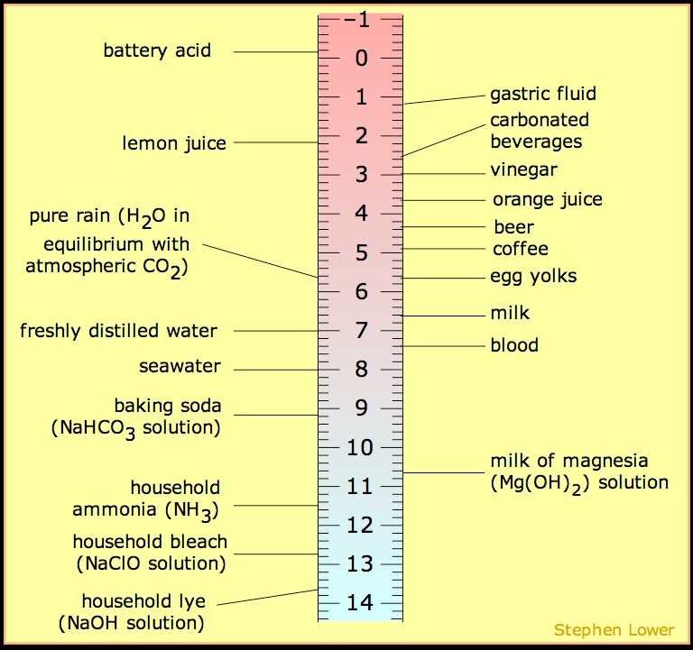
16.4 pH scale

Slide 53
16.4 Other p scales
pOH = -log[OH-]
Based on self ionization of water…
[H+][OH-] = 1.0 x 10 ^ -14
Taking the negative log of both sides…
-log[H+] + (-log[OH-]) = 14
Therefore
pH + pOH = 14

Slide 54
16.4 Calculating pH from pOH
What is the pH of a solution whose pOH is 3?
What is the concentration of OH- ions in a solution whose pH is 4.12?

Slide 55
16.5 Strong Acids and Bases
Strong Acids - the seven most common strong acids are listed below
Monoprotic: HCl, HI, HNO3, HBr, HClO3, and HClO4
Diprotic: H2SO4
For all practical purposes, an aqueous solution of HNO3 consists entirely of H3O+ and NO3- ions….
If concentrations are less 1.0 x 10^-6 M, we must take into account the auto ionization of water

Slide 56
16.5 Strong Acids
For a monoprotic strong acid, the pH of the solution is very straightforward
[H+] is equal to the concentration of the original solution
pH can easily be calculated from -log[H+]
A 0.20 M HNO3 solution has an [H+] of 0.20 M as well (complete ionization)

Slide 57
16.6 Strong Basee
There relatively few common bases….
Mostly ionic hydroxides of group 2a such as KOH, NaOH, and Ca(OH)2
A 0.30 M NaOH (aq) solution is “completely” ionized and is also 0.30 M OH-
0.30 M NaOH (aq) —> 0.30 M Na+ (aq) + 0.30 M OH- (aq)

Slide 58
16.6 Strong Base
Calculate the pH of a 0.028 M solution of NaOH
Calculate the pH of a 0.0011 M solution of Ca(OH)2

Slide 59
16.6 Weak Acids
Most acidic substances are weak acids and therefore are only partially ionized
Keq can used to determine to what extent a weak acid ionizes
HA (aq) + H2O (l) <——> H30+ (aq) + A- (aq)

Slide 60
16.6 Weak acids
Are typically organic compounds composed entirely of hydrogen, carbon, and oxygen
They contain some hydrogen atoms and some bonded to oxygen atoms
In most cases the hydrogens attached to carbon do not ionize, whereas those bound to oxygen will

Slide 61
16.6 Ionization of Acetic Acid

Slide 62
16.6 Ka
Ka - acid dissociation constant (another version of Keq)
Smaller value of Ka, the weaker the acid
Larger value of Ka, the stronger the acid

Slide 63
16.6 Calculating Ka of pH
To calculate Ka from pH, we must first determine the concentration of H+ in solution
Typically you will also known the prepared concentration
From there we can make an ICE table to determine concentrations of the weak acid and dissociated ions to calculate Ka

Slide 64
16.6 5% Approximation
During the calculation of Ka, if the ionization of the weak acid is less than 5%...
Then we can drop the extra x in the denominator based up significant figures
Approximation = [H+]/[HA] x 100% must be less than 5%

Slide 65
16.6 ICE table practice
Calculate the OH- concentration in a 0.15 M NaOH solution of NH3
Write the chemical equation first
Kb = 1.8 x 10 ^ -5

Slide 66
16.6 Practice Problem
Calculate Ka from a 0.10 M formic acid solution (HCHO2)
pH was measured to be 2.38 at 25 degrees Celsius
Here come the ICE tables!!

Slide 67
16.6 Polyprotic Acids
Polyprotic acids – acids in which there is more than one ionizable hydrogen
Dissociation constants are labeled Ka1, Ka2, and so forth
The first ionizable hydrogen will always dissociate easier
Easier to remove the proton from the neutral atom
Ka1 will always be the largest

Slide 68
16.6 Polyprotic Acids
Sulfuric acid is the only common polyprotic acid, and is considered completely ionized based on the removal of the first proton
Otherwise, as long as Ka1 and Ka2 differ by a factor of 10^3 or more….
It is satisfactory to calculate the pH based on Ka1

Slide 69
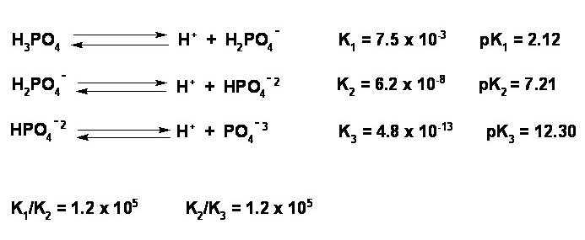
16.6 Polyprotic Acids

Slide 70
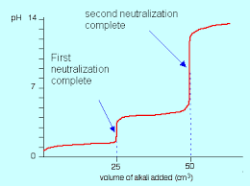
16.6 Titration of Polyprotic Acids

Slide 71
16.7 Weak Bases
Many substances act as weak bases in water
Important take away from this…
Weak bases attract a proton
Strength of the base can be interpreted as the value of its Kb

Slide 72
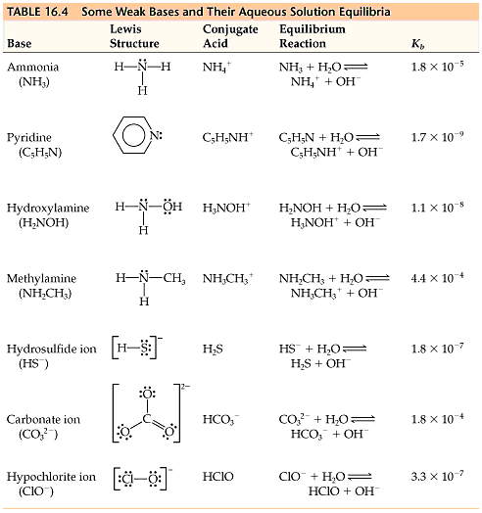
16.7 Common Weak Bases

Slide 73
16.8 Types of Weak Bases
Type 1: Have a lone pair of electrons, typically nitrogen
Lone pair is necessary to form the bond with H+
Type 2: Are the anion of a weak acid ( conjugate base)
Kw = Ka x Kb → Last little tid bit of info in terms of constants, if you know one you can find the other (at 25 degrees C)

Slide 74
16.9 What determines the Strength of Acids?
At the molecular level…
Binary acids H-X, depends on the bond strength
Bond strength decreases as atomic size increases
Acidity increases as size increases (down a group)
Across a row, as electronegativity increases, acidity increases

Slide 75
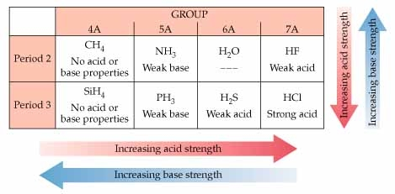
16.9 Acid Strength Trend

Slide 76
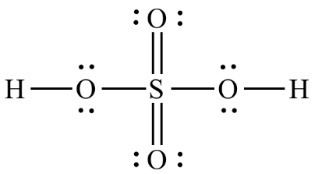
16.9 Strength of Oxyacids
Some oxyacids have OH groups attached, what determines whether they will act as acids or bases?
Depends on the electronegativity of the central atom

Slide 77
16.9 Strength of Oxyacids
If we consider the bonded group attached to an OH- ion… Y–O-H
If Y is a metal (Na, K, or Mg), which has low electronegativity, Y completely transfers its electrons to an OH- group and acts as a base

Slide 78
16.9 Strength of Oxyacids
Y-O-H
If Y is a nonmetal, the bond to O is covalent, and the substance does not readily lose OH-
2 Reasons
Electron density is favored by the Oxygen atom, and is more likely to form H+
Electronegative elements form a more stable anion (A-) as the conjugate base.

Slide 79
16.9 Strength of Oxyacids
In general, the more Oxygen atoms surrounding the central atom, polarizes the O-H bond, and increases the strength of the acid i.e.
Favorability to lose H+, rather than OH-

Slide 80
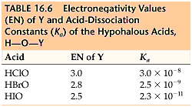
16.9 Strength of Oxyacids

Slide 81
16.10 Lewis Acids
Lewis acid – electron pair acceptor
Lewis base – electron pair donator
Lewis bases can donate their electrons to other compounds besides H+ which greatly increases the number of species that can be considered acids
We have already mentioned this in that bases need to have a lone pair of electrons to react with H+

Slide 82
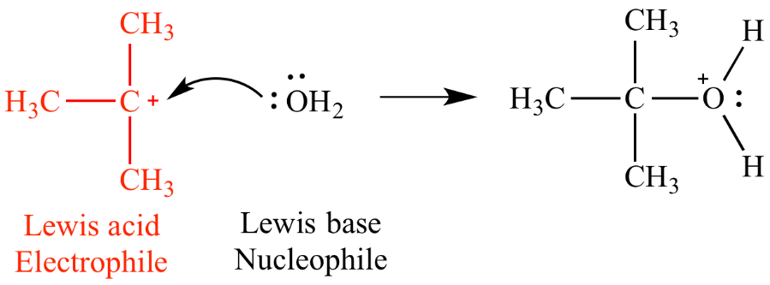
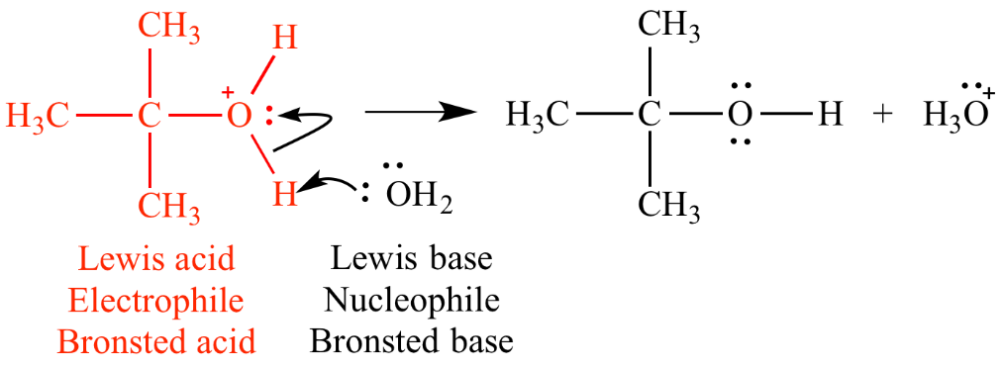
16.11 Example Mechanism
Lewis acid is also called an electrophile
1
2

